Slide 1
Ellipsis Hackathon 2020
Empowering youths to grow their money
Team: Code Warriors
Areeba Khan
Olivia Bi Haiqing
Leow Hong Ee
Tay Qifang
Notes:
Hello everyone! We are code warriors, and today we are going to present to you our solution to empower youths to grow their money.

Slide 2

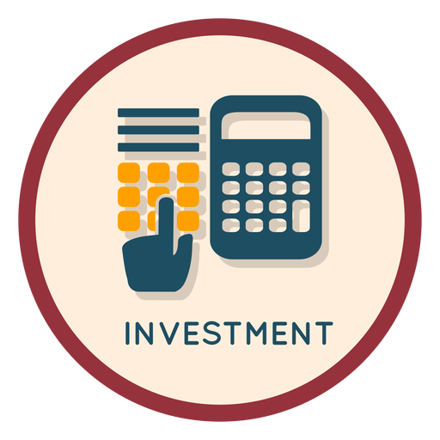

SOLUTION ARCHITECTURE
BUSINESS
APPLICATION
Providing basic investment knowledge and options
Target user:
Youths
Web application to help youths to identify the best investment approach based on a set of questions
Notes:
Our solution is a web application to help youth identify the best investment instruments by providing basic investment knowledge and options.

Slide 3


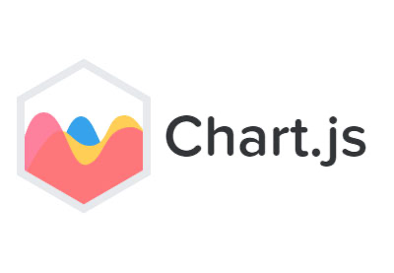



TECHNOLOGY USED
FRONTEND
BACKEND
DATABASE
INSTANCE
Notes:
These are the technology we used.

Slide 4
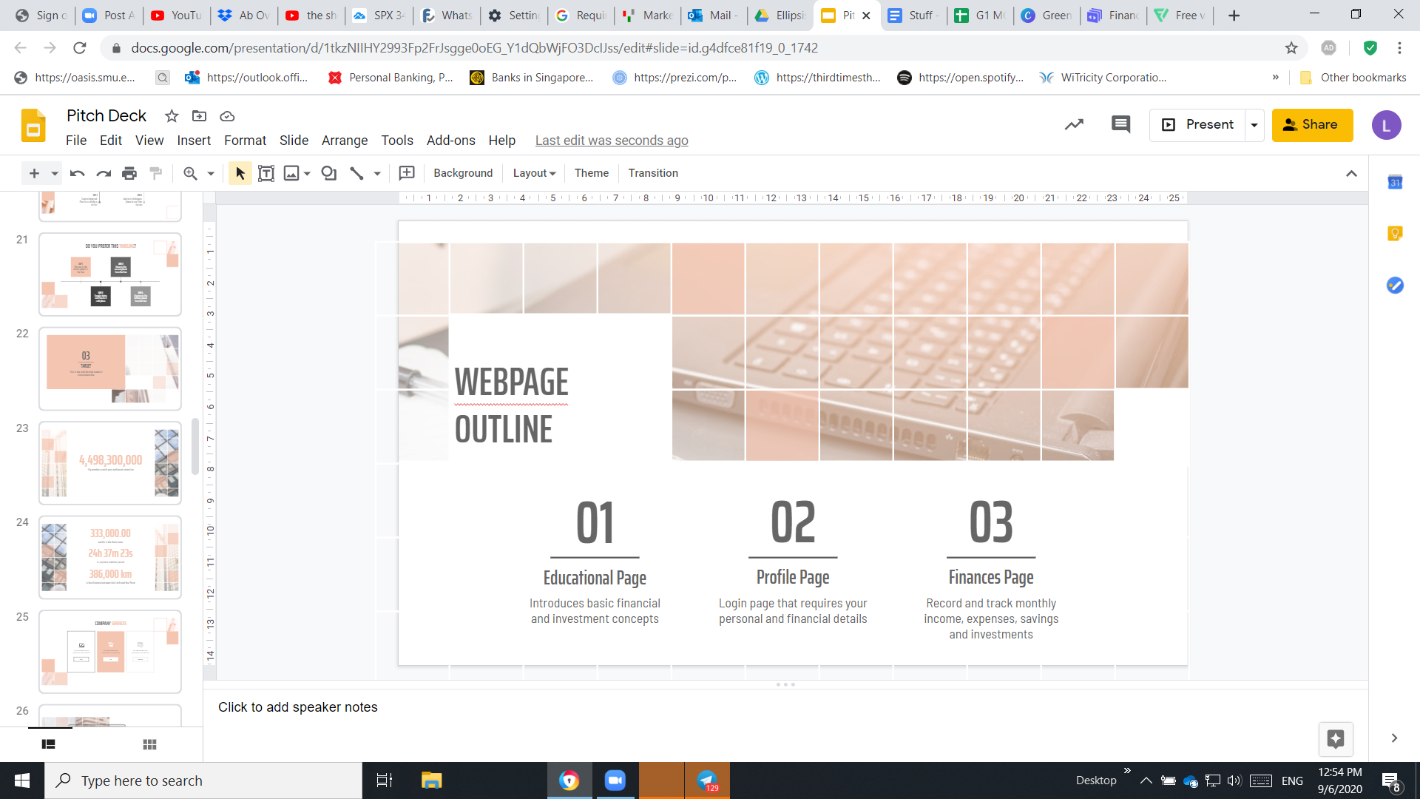
WEBPAGE OUTLINE
01
02
03
04
Educational Page
Profile Page
Finances Page
Dashboard
Introduces basic financial and investment concepts
Login page that requires your personal details and a test to determine their investment preference
Record and track monthly income, expenses, savings and investments
Recommends the appropriate investment approach and tools
Notes:
The webpage includes 4 parts in total, educational, profile, finances and dashboard.

Slide 5
01
Educational Page
“Knowledge is Power”
Notes:
Let us move to the first page. We believe education is the power.

Slide 6
HOW TO GROW YOUR MONEY: INVESTING 101
Time Value of Money
Portfolio Diversification
Active vs Passive Investing
Savings account, Stocks, Bonds, Commodities, Funds
Concepts
Investment Approaches & Tools
Panic Selling
Investment Biases
Investment Traps
Online Courses and Materials
Notes:
To enable youths to grow their money, necessary investing knowledge is a must. In the education page, we offer basic explanations of investing concepts and approaches, reminders of some common investment traps, and lastly links to quality online courses and materials if they requires a further dig-in.

Slide 7
02: Profile Page
A QUIZ TO DETERMINE YOUR INVESTMENT PREFERENCE
Knowledge
Passion
Time
Risk Appetite
Capital
THE RESULT
Do you own necessary investing competencies
Do you have a passion for investing
Do you have spare time to monitor your instruments
Are you open to risk
Do you have capital to start
You are a passive / active investor
“Knowing yourself is the first step to success”
Notes:
Where we includes a short quiz to determine the users’ investment preference from the 5 aspects, by which the youths can see right away if they are active or passive investors.

Slide 8
03
Finances Page
“When you fail to plan, you plan to fail”
Notes:
Moving on to the third part, which is the finances page.

Slide 9
Budgetary Table
INCOME
EXPENDITURE
SAVINGS
INVESTMENTS
Notes:
The page is meant for youth to monitor their wealth flow by consciously key in their income, expenditure, savings and investment.

Slide 10
04: Dashboard
THREE PARTS OF DASHBOARD
Your details:
User Name
Email
Education Level
Type of investor
Your financial activities:
A graph summing the financial page
Current savings
Goals
Progress
Recommendation for you:
Top 3 investment tools
Asset allocation of each investment tool
Recommending the best investment solution for you.
Notes:
It is made up of three parts: your confidentials, a graph tracking your financial activities, and the recommendation of investment tools we have for you given your profile test results.

Slide 11
THANK
YOU!
05
LIVE DEMO
http://18.141.167.95/ellipsisHackathon/index.html

